Slide 1
COMP4925 , sub-project 1
Norman Lim
Daniel Lin
Manveer Bhangu

Slide 2

The San Francisco Salaries Dataset
San Francisco GDP increased by 155 Billion within the span of 13 years, 2001-2014.
Averages out to an increase of approximately 12 Billion each year
Dataset focuses on the latest few years from 2011 to 2014.

Slide 3
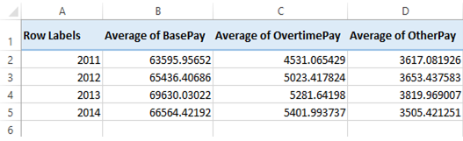
Hypothesis 1
The increase in GDP should definitely reflect an increase in salary overall. We wanted to see if the apparent increase of the salary is a significant amount.
*created with an excel PivotTable

Slide 4
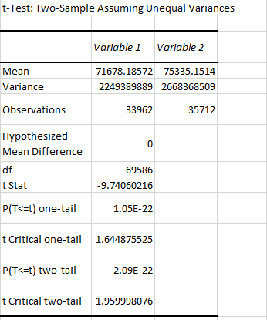
Hypothesis 1 Conclusions
Using t-Test (unequal variance): Two Sample for Means, we examined total salary from 2011 and 2014 to see if there are any significant difference over 4 years.
We found that there is a significant probable difference between the year 2011 and 2014 in terms of salary.

Slide 5
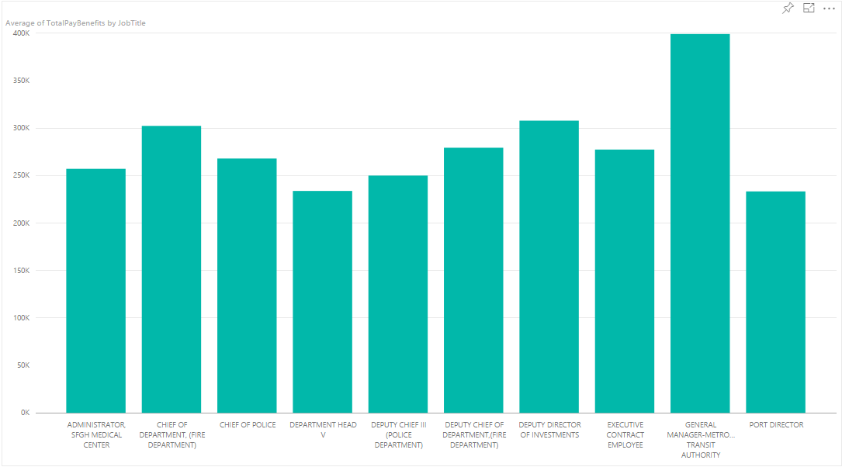
Hypothesis 2
After playing around with the data, we managed to find the highest paid occupations in San Francisco in 2011.
Hypothesis:
Those occupations will most likely see an increase in salary over the next 3 years.

Slide 6
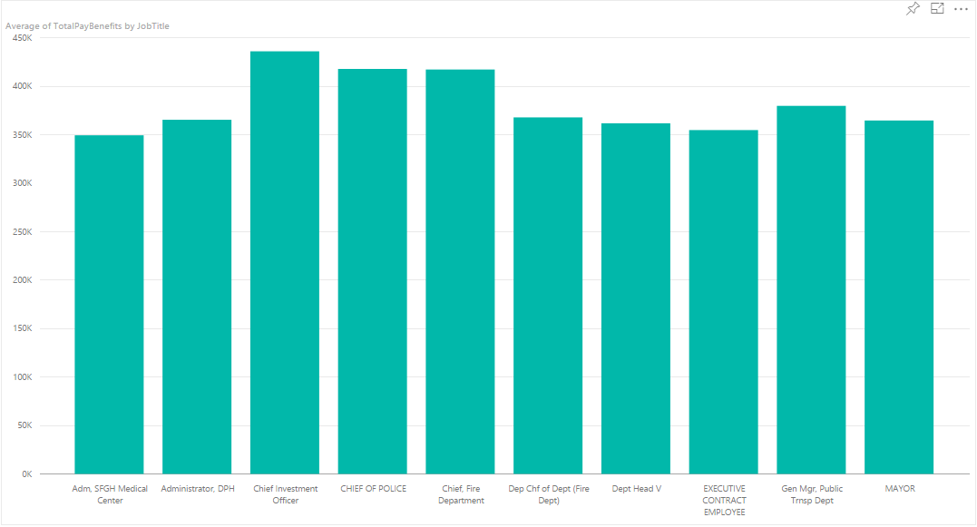
*most highest paying jobs in 2011 were slightly below the 250k range.
*almost all highest paying jobs in 2014 are over the 350k range.

Slide 7
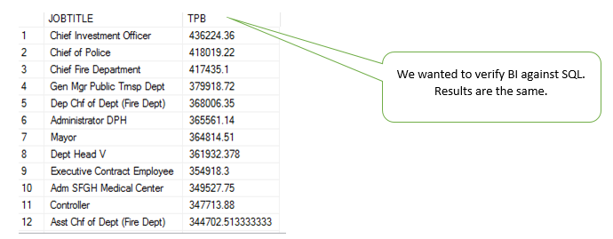
This was because PowerBI is a unstructured learning, and we wanted to actually understand the data? lol

Slide 8
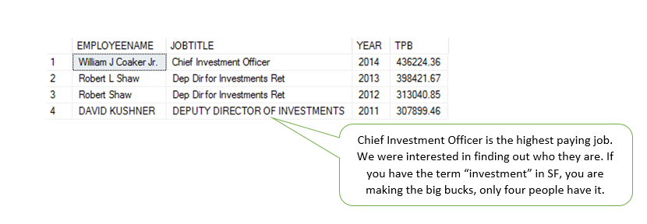
Also, a recurring trend shows that someone with the title “Investor” will always present in the Top 10 salaries. They even took the Top 1 spot in 2014.

Slide 9
List of highest paying jobs in 2011
- Administrator, SFGH medical center
- Chief of Department(fire department)
- Chief of Police
- Department Head V
- Deputy Chief III (police department)
- General manager metro transit authority
- Port director
- Executive contract employee
- Deputy chief of department (fire department)
- Deputy director of investments
List of highest paying jobs in 2014
- Administrator San Francisco General Hospital Medical Center
- Chief of Department (Fire Department)
- Chief of Police
- Department Head
- Deputy Chief
- General Manager of Transit Authority
- Port Director
- Executive Contract Employee
- Mayor
- Chief Investment Officer

Slide 10

Hypothesis 2 Conclusion
Almost all the highest paid occupations remained in their top spots, with a salary increase of almost 50k-100k increase over the span of 4 years.

Slide 11
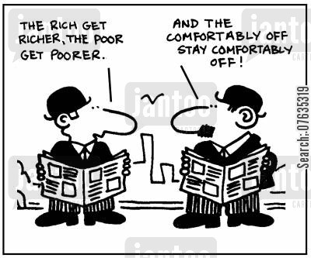
Hypothesis 3
Since we know that there is a significant increase in salary for the top paying jobs, we believe that the middle-class should experience an increase as well.
However, we believe that the increase will not be as significant as the top paying jobs.

Slide 12
Choosing the 10 Mid-class jobs.
We did not want to choose the people on the opposite side of the spectrum, as that would be a bias comparison.
We chose people within the salary range of $25,000 - $32,000 as it was the rough midpoint of the dataset.

Slide 13
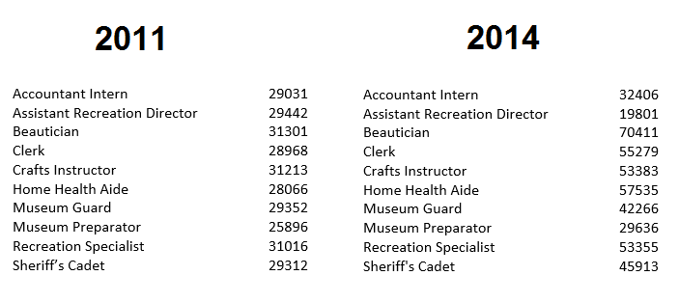
Our Mid-Class Dataset

Slide 14
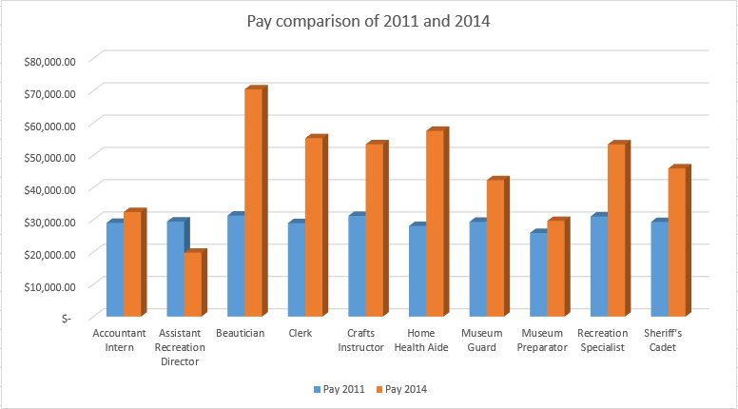
Bar Graph Results

Slide 15
Hypothesis 3 Conclusion
Most jobs saw an increase in Salary as well, therefore we can conclude that almost all jobs, even lower paying jobs saw an increase in salary within this 4 year period.

